Slide 1
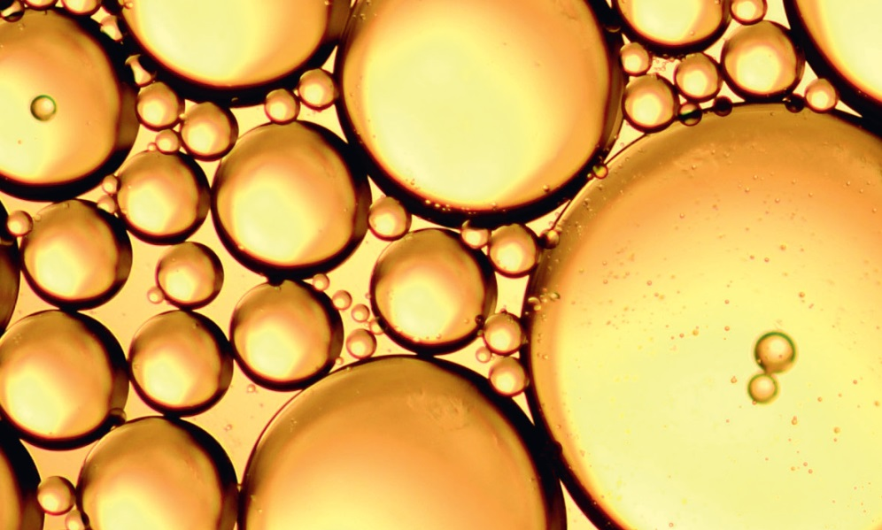
Chapter 2: Classifying and separating substances

Slide 2
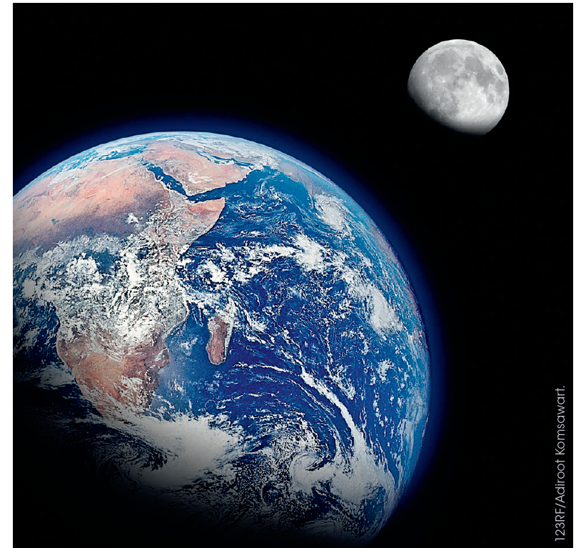
Classifying matter
The type of substances that a material is composed of and the way these substances are combined can be used to classify materials.

Slide 3
Classifying matter
Pure substances
Mixtures
Material properties dependent on the identity and relative amounts of the substances that make up the mixture
Materials with distinct measurable properties (melting and boiling point, reactivity, strength, density)

Slide 4
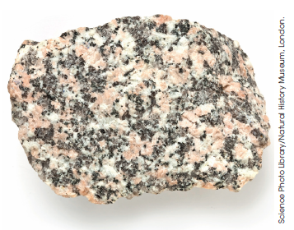
Heterogeneous material
Classifying matter
Two or more different substances
Proportions can vary
Mixtures non-uniform

Slide 5
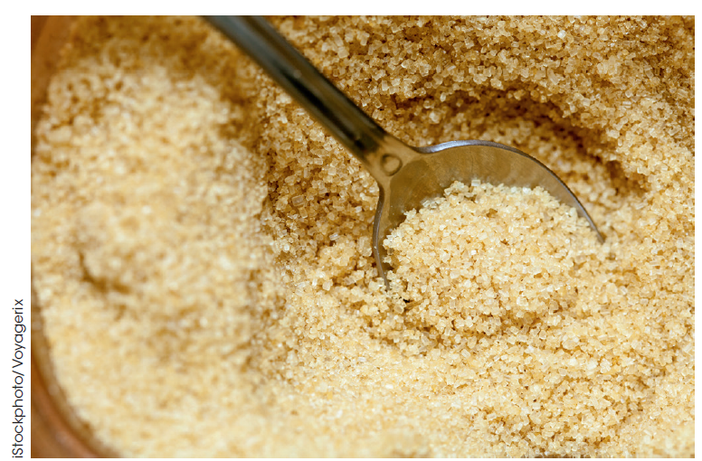
Homogeneous material
Classifying matter
Uniform composition
Pure substances: elements /compounds
Solution; the only mixture that can be homogenous

Slide 6
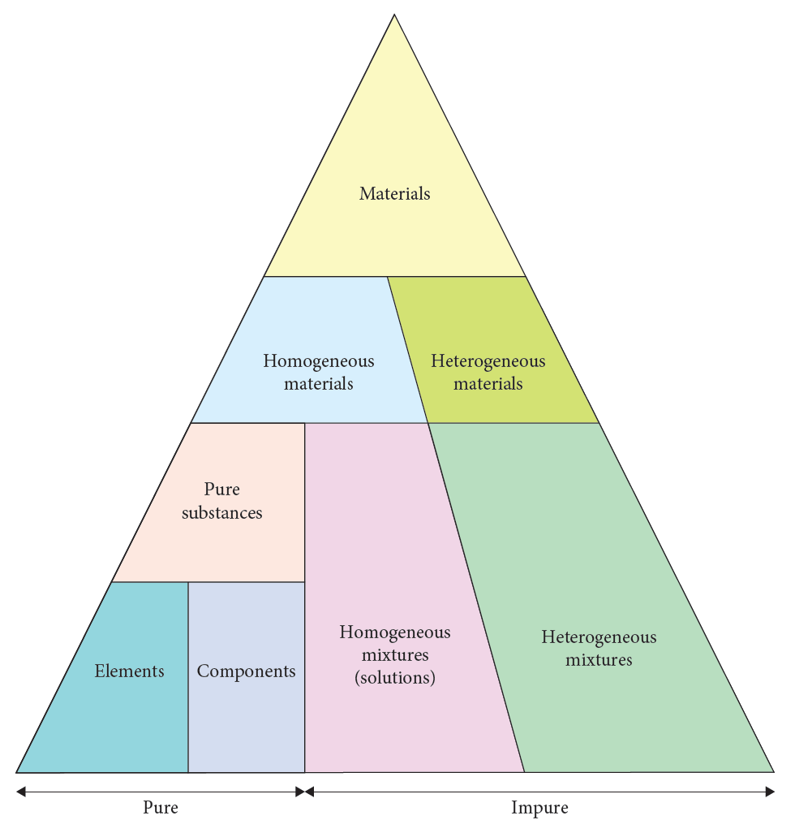
Classification of materials

Slide 7
Physical and chemical properties
Pure substances
Mixtures
Has distinct measurable properties
Can be used to identify substances
The properties depend on both the identity and relative amounts of substances that make up the mixture.
The properties of the components in a mixture determines the technique used to separate them.

Slide 8
Physical properties
Can be determined without changing the chemical compositions
Differences allow identification.
E.g:
melting point
boiling point
electrical conductivity
thermal conductivity
strength
density
solubility
state
ductility
malleability

Slide 9
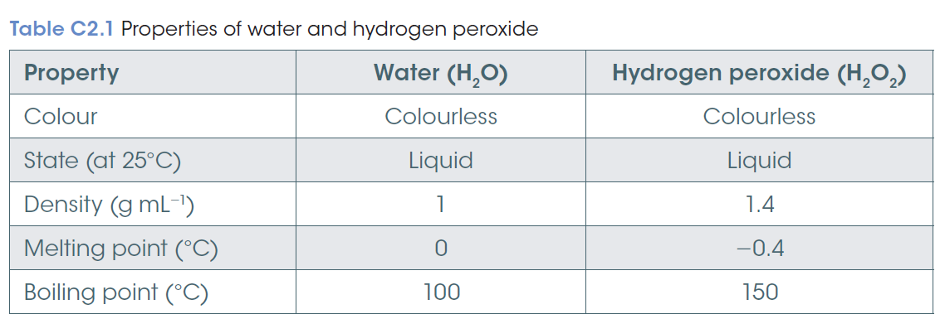
Physical properties

Slide 10
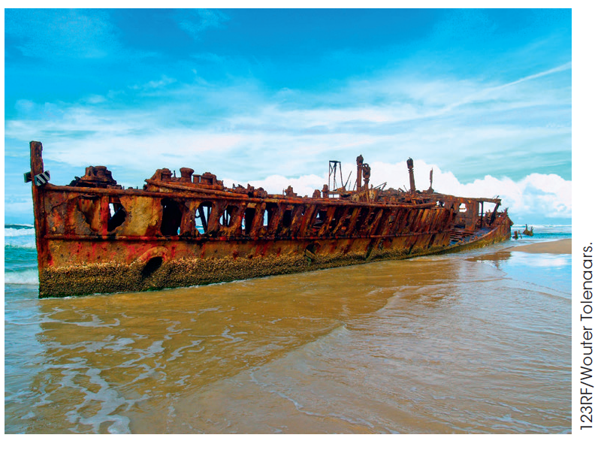
Chemical properties
Relate to the reactions that form new substances
E.g:
decomposition by heat,
effect of light,
reactions with;
- water
- acids
- bases
- oxygen
- & other substances

Slide 11
Physical and chemical changes
Physical change
Chemical change
Changes in the physical properties such as density, state and colour.
No change in chemical composition
e.g. tearing paper
Chemical change: at least one new substance is formed.
Different chemical and physical properties
e.g. burning, digestion

Slide 12
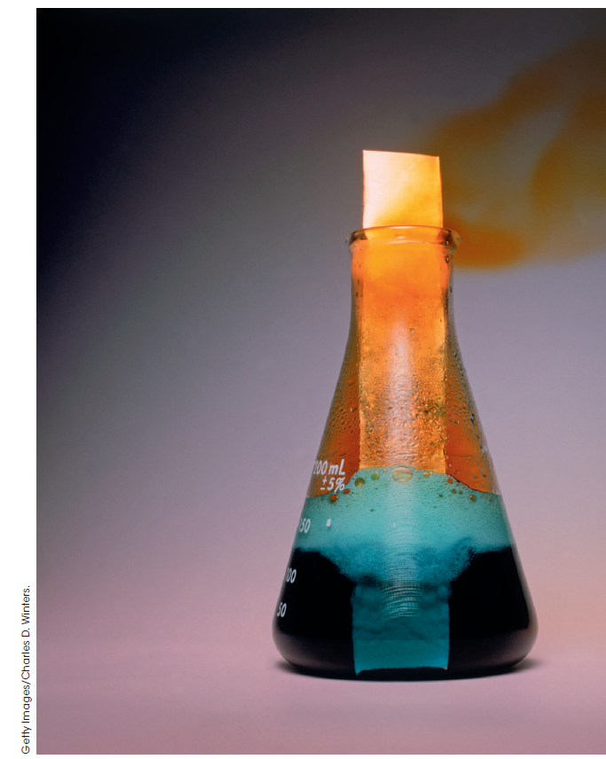
Chemical change recognised by
solid (precipitate) is formed
gas produced
colour change
significant change in temperature
an insoluble solid disappears

Slide 13
The properties of the components in a mixture determine the technique used to separate them.

Slide 14
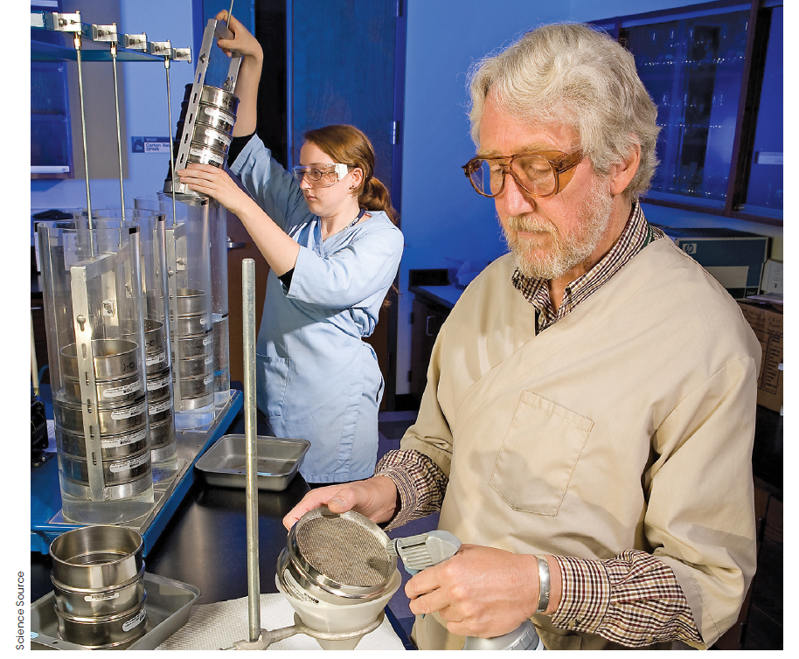
Separation by difference in particle size
Sieving

Slide 15
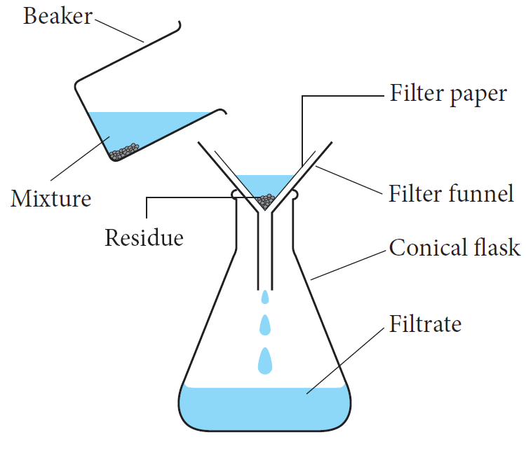
2.3 Separating mixtures
Separation by differences in boiling point
Vaporisation, Distillation,
Fractional distillation

Slide 16
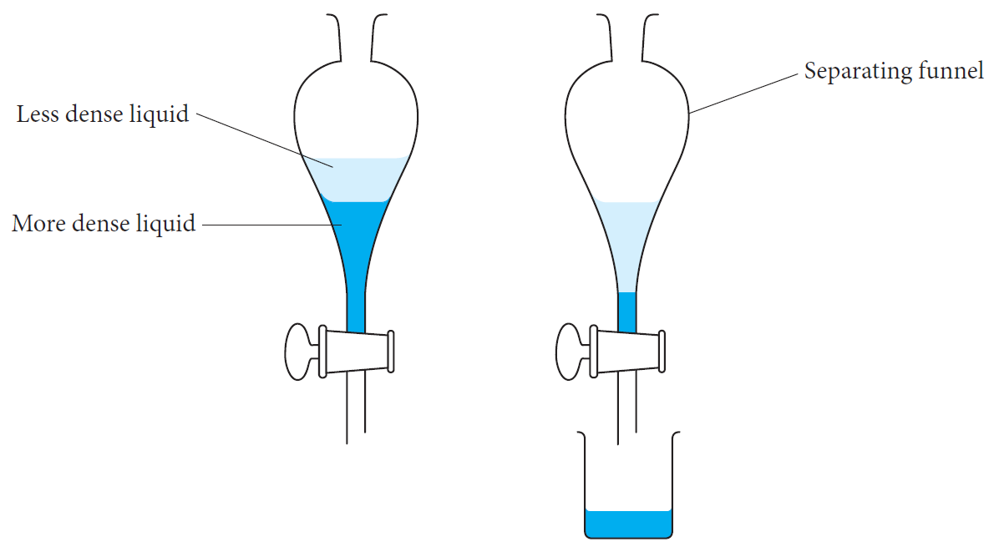
Separation by density and solubility
Immiscible liquids separate into two layers due to density.

Slide 17
Separation by magnetism and electrostatic attraction
Magnetic separation uses the degree of attraction to a magnetic field.
e.g. iron, cobalt and nickel
Electrostatic separation relies upon the differences in electrical charge.
e.g. mineral sands containing zircon, rutile and monazite

